Slide 1
OPERATING SYSTEMS (CS F372) Virtual Memory Management
Barsha Mitra
CSIS Dept., BITS Pilani, Hyderabad Campus

Slide 2
Background
Code needs to be in memory to execute
Entire program code not needed at same time
Consider ability to execute partially-loaded program

Slide 3
Background
Virtual memory – separation of logical memory from physical memory
Only part of the program needs to be in memory for execution
Logical address space can be much larger than physical address space
Allows address spaces to be shared by several processes
More programs running concurrently
Less I/O needed to load or swap processes
Virtual address space – logical view of how process is stored in memory
Usually start at address 0, contiguous addresses until end of space
Physical memory organized in page frames
MMU maps logical addresses to physical addresses

Slide 4
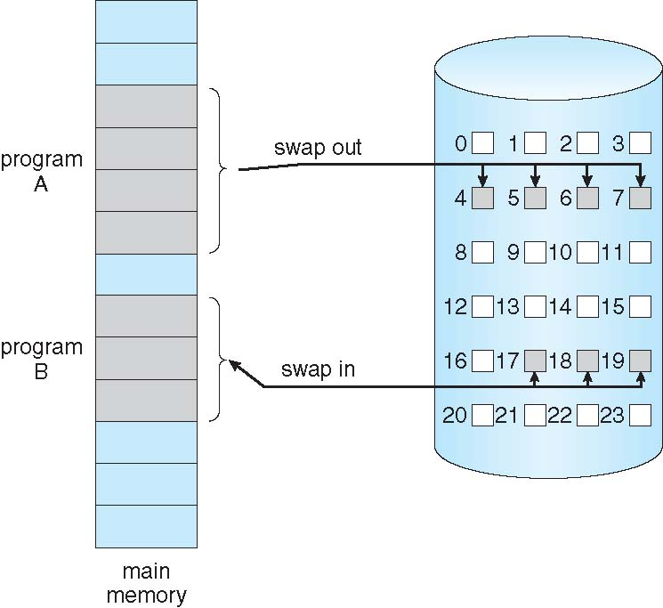
Demand Paging
Bring a page into memory only when it is needed
Less I/O needed, no unnecessary I/O
Less memory needed
Faster response
More users
Page is needed ⇒ reference to it
invalid reference ⇒ abort
not-in-memory ⇒ bring to memory
Lazy Swapper, Pager

Slide 5
Demand Paging
Pager guesses which pages will be used before swapping out again
Pager brings in only those pages into memory
How to determine that set of pages?
Need new MMU functionality to implement demand paging
If pages needed are already memory resident
If page needed and not memory resident

Slide 6
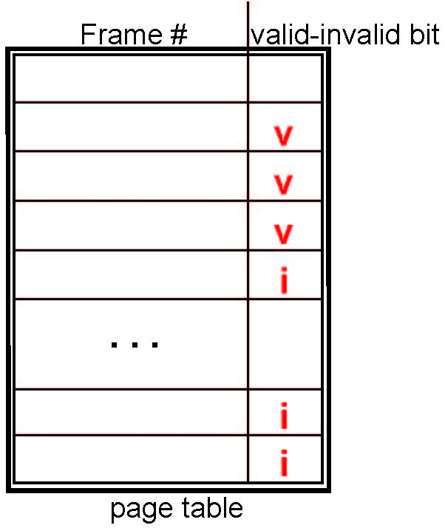
Valid-Invalid Bit
With each page table entry a valid–invalid bit is associated
v ⇒ legal and in-memory – memory resident
i ⇒ either illegal or not-in-memory
Initially valid–invalid bit is set to i on all entries
During MMU address translation, if valid–invalid bit in page table entry is i ⇒ page fault

Slide 7
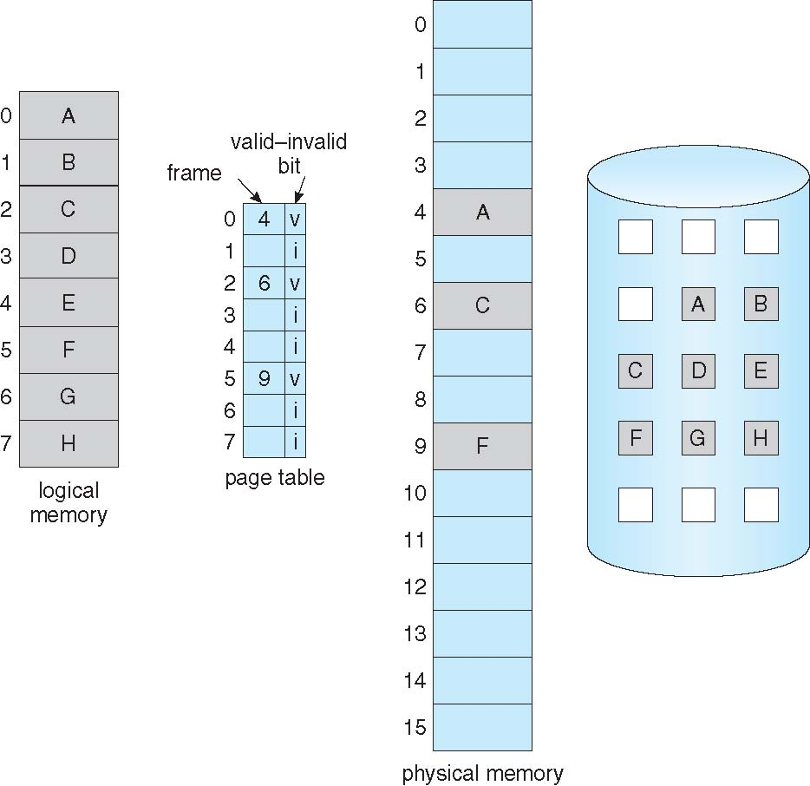
Valid-Invalid Bit

Slide 8
Page Fault
If there is a reference to a page, first reference to that page will trap to operating system: page fault
Operating system looks at an internal table (usually associated with PCB) to decide:
Invalid reference ⇒ abort
Just not in memory
Find free frame
Swap page into frame via disk operation
Reset page table to indicate page now in memory Set valid/invalid bit = v
Restart the instruction that caused the page fault

Slide 9
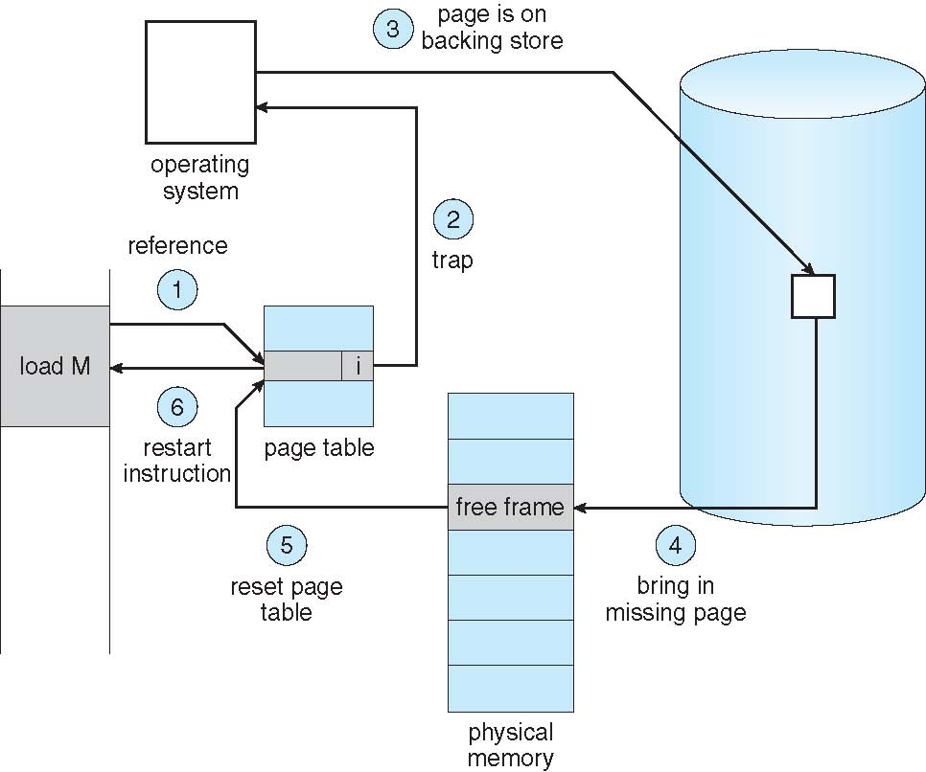
Page Fault

Slide 10
Demand Paging
Pure Demand Paging
Locality of reference - tendency of a processor to access the same set of memory locations repetitively over a short period of time
Hardware support needed for demand paging
Page table with valid / invalid bit
Secondary memory (swap device with swap space)
Instruction restart

Slide 11
Performance of Demand Paging
Three major activities
Service the interrupt
Read the page
Restart the process
Page Fault Rate 0 ≤ p ≤ 1
if p = 0 no page faults
if p = 1, every reference is a fault
Effective Access Time (EAT)
EAT = (1 – p) x memory access + p (page fault overhead
+ swap page out + swap page in )

Slide 12
Demand Paging Example
Memory access time = 200 nanoseconds
Average page-fault service time = 8 milliseconds
EAT = (1 – p) x 200 + p (8 milliseconds)
= (1 – p) x 200 + p x 8,000,000 = 200 + p x 7,999,800

Slide 13
Page Replacement
Use modify (dirty) bit to reduce overhead of page transfers – only modified pages are written to disk
Page replacement completes separation between logical memory and physical memory
Find the location of the desired page on disk
Find a free frame: - If there is a free frame, use it - If there is no free frame, use a page replacement algorithm to select a victim frame - Write victim frame to disk if dirty
Bring the desired page into the (newly) free frame; update the page and frame tables
Continue the process by restarting the instruction that caused the trap

Slide 14
First-In-First-Out (FIFO) Algorithm
Reference string: 7,0,1,2,0,3,0,4,2,3,0,3,2,1,2,0,1,7,0,1 3 frames
Try for 1, 2, 3, 4, 1, 2, 5, 1, 2, 3, 4, 5
Adding more frames can cause more page faults!
Belady’s Anomaly
7 0 1 2 0 3 0 4 2 3 0 3 2 1 2 0 1 7 0 1
7
7
7
2
2
2
4
4
4
0
0
0
7
7
7
0
0
0
3
3
3
2
2
2
1
1
1
0
0
1
1
1
0
0
0
3
3
3
2
2
2
1

Slide 15
Optimal Algorithm
Replace page that will not be used for longest period of time
9 is optimal for the example
How do you know this?
Can’t read the future
Used for measuring how well your algorithm performs
7 0 1 2 0 3 0 4 2 3 0 3 2 1 2 0 1 7 0 1
7
7
7
2
2
2
2
2
7
0
0
0
0
4
0
0
0
1
1
3
3
3
1
1

Slide 16
Least Recently Used (LRU) Algorithm
Use past knowledge rather than future
Replace page that has not been used in the most amount of time
Associate time of last use with each page
Better than FIFO but worse than OPT
Generally good algorithm and frequently used
But how to implement?

Slide 17
Least Recently Used (LRU) Algorithm
Counter implementation
Every page table entry has a counter; every time page is referenced through this entry, copy the clock into the counter
When a page needs to be changed, look at the counters to find smallest value
Stack implementation
Keep a stack of page numbers
Page referenced - move it to the top
LRU and OPT don’t have Belady’s Anomaly

Slide 18
Least Recently Used (LRU) Algorithm
7 | 0 | 1 | 2 | 0 | 3 | 0 | 4 | 2 | 3 | 0 | 3 | 2 | 1 | 2 | 0 | 1 | 7 | 0 | 1

Slide 19
Allocation of Frames
Each process needs minimum number of frames, decided by computer architecture
Maximum of course is total frames in the system
Two major allocation schemes
Equal allocation
Proportional allocation

Slide 20
Frame Allocation
Equal allocation – For example, if there are 100 frames (after allocating frames for the OS) and 5 processes, give each process 20 frames
Proportional allocation – Allocate according to the size of process
Dynamic as degree of multiprogramming, process sizes change
Assume that 2 frames will be allocated for OS out of 64

Slide 21
Thrashing
If a process does not have “enough” pages, the page-fault rate is very high
Page fault to get page
Replace existing frame
But quickly need replaced frame back
This leads to:
Low CPU utilization
Operating system thinking that it needs to increase the degree of multiprogramming
Another process added to the system
Thrashing ≡ a process is busy swapping pages in and out, high paging activity

Slide 22
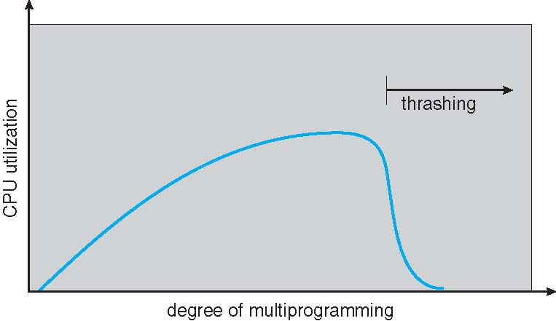
Thrashing

Slide 23
Demand Paging & Thrashing
Why does demand paging work? Locality model
Locality is a set of pages that are actively used together
Defined by program structure and data structures used
Process migrates from one locality to another
Localities may overlap
Why does thrashing occur?
Limit effects by using local page replacement
Allocate enough frames for a single locality

Slide 24
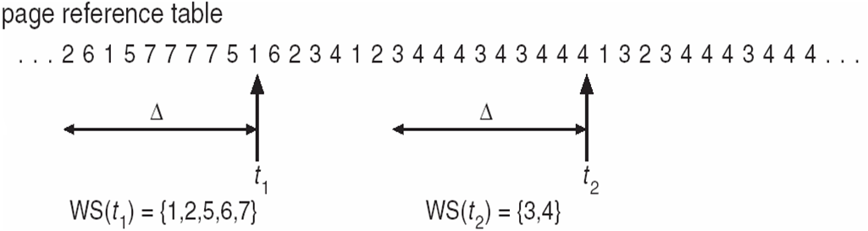
Working Set Model
Δ ≡ working-set window ≡ a fixed number of page references (usually most recent), approximation of program’s locality

Slide 25
Working Set Model
WSS_{i} (working set of P_{i}) = total no. of pages referenced in the most recent Δ (varies in time)
if Δ too small will not encompass entire locality
if Δ too large will encompass several localities
if Δ = ∞ ⇒ will encompass entire program
D = Σ WSS_{i} ≡ total demand for frames
m = no. of available frames
if D > m ⇒ Thrashing
D > m, then suspend or swap out one of the processes
Keeps the degree of multiprogramming as high as possible
Optimizes CPU utilization
Difficulty is to keep track of the working set

Slide 26
Page Fault Rates
Page-Fault Frequency (PFF)
Define an upper and lower limits of page fault rate
If page fault rate is too low → take away a frame
If page fault rate is too high → allocate one more frame

Slide 27
Allocating Kernel Memory
Treated differently from user memory
Often allocated from a free-memory pool
Kernel requests memory for data structures of varying sizes, maybe smaller than a page
Some kernel memory needs to be contiguous
i.e., for device I/O, h/w devices interact directly with physical memory

Slide 28
Buddy System
Allocates memory from fixed-size segment consisting of physically-contiguous blocks
Define a maximum and minimum block size
Memory allocated using power-of-2 allocator
Satisfies requests in units sized as power of 2
Splitting memory into halves and to try to give a best fit
When smaller allocation needed than is available, current chunk split into two buddies of next-lower power of 2
Continue until appropriate sized chunk available

Slide 29
Contd…
Provides two operations:
Allocate(A, 2^{k}) : Allocates a block A of 2^{k} and marks it as allocated
Free(A): Marks the previously allocated block A as free and merge it with other blocks to form a larger block
Algorithm: Assume that a process P of size “X” needs to be allocated
If 2^{K-1}<X<=2^{K}: Allocate the entire block 2^{K}
Else: Recursively divide the block equally and test the condition at each time, when it satisfies, allocate the block.

Slide 30
Advantages and Disadvantages
Advantage –
Easy to implement a buddy system (Linux)
Allocates block of correct size
It is easy to merge adjacent holes - coalescing
Fast to allocate memory and de-allocating memory
Disadvantage –
It requires all allocation unit to be powers of two
It leads to internal fragmentation

Slide 31
Problem 1
Consider a memory block of 16K. Perform the following:
Allocate (A: 3.5K)
Allocate (B: 1.2K)
Allocate (C: 1.3K)
Allocate (D: 1.9K)
Allocate (E: 3.2K)
Free (C)
Free (B)
Allocate (F: 1.6K)
Allocate (G: 1.8K)

Slide 32
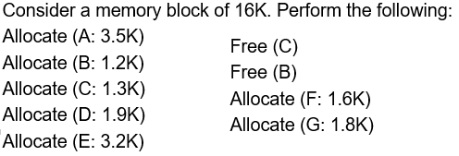
16K Memory Block
Allocate (A: 3.5K)
Allocate (B: 1.2K)
Allocate (C: 1.3K)
Allocate (D: 1.9K)
16K
4K (A) | 4K | 8K
4K (A) | 2K(B) | 2K | 8K
4K (A) | 2K(B) | 2K(C) | 8K
4K (A) | 2K(B) | 2K(C) | 2K(D) | 2K | 4K

Slide 33
Allocate (E: 3.2K)
Free (C)
Free (B)
Allocate (F: 1.6K)
Allocate (G: 1.8K)
4k (A) | 2K(B) | 2K(C) | 2K(D) | 2K | 4K(E)
4k (A) | 2K(B) | 2K | 2K(D) | 2K | 4K(E)
4k (A) | 2K | 2K | 2K(D) | 2K | 4K(E)
4k (A) | 4K | 2K(D) | 2K | 4K(E)
4k (A) | 4k | 2K(D) | 2K(F) | 4K(E)
4k (A) | 2K(G) | 2K | 2K(D) | 2K(F) | 4K(E)

Slide 34
Tree Structure

Slide 35
Problem 2
Consider the state of memory after allocating 5 processes A, B, C, D and E
What is the state of memory after freeing process D?
What is the state of memory after freeing Process C?
4k (A) | 2K(B) | 2K(C) | 2K(D) | 2K(E) | 4K
4k (A) | 2K(B) | 2K(C) | 2K | 2K(E) | 4K
4k (A) | 2K(B) | 2K | 2K | 2K(E) | 4K
Wrong!
4k (A) | 2K(B) | 4K | 2K(E) | 4K

Slide 36
Thank You

